Slide 1
Software Modelling

Slide 2
Software Modeling
Software models are ways of expressing a software design.
Usually some sort of abstract language or pictures are used to express the software design.
For object-oriented software, an object modeling language such as UML is used to develop and express the software design.
There are many different ways of designing software. Different developers prefer different amounts of design up front or during implementation phase.

Slide 3
Different Software Modelling Techniques
UML Class Diagrams information structure relationships between data items modular structure for the system | Use Cases user’s view Lists functions visual overview of the main requirements
UML Package Diagrams Overall architecture Dependencies between components | (UML) Statecharts responses to events dynamic behavior event ordering, reachability, deadlock, etc
UML Sequence Diagrams individual scenario interactions between users and system Sequence of messages | Activity diagrams business processes; concurrency and synchronization; dependencies between tasks;

Slide 4
Class Diagram Model
Class diagrams are the main building block in object-oriented modeling
In this model, Number of classes are identified and grouped together that helps to determine the relations between them.
Think of differnt objects/entities in the domain being modeled
These entities are the candidates to become classes in our model
These entities/objects are interrealted to each other in specific ways, thus the class model needs to show these relationships as well

Slide 5
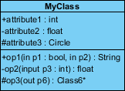
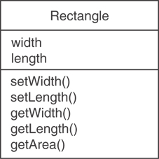
Turning objects into classes
This process will involve finding out the attributes and operations for that object
Attributes will beome the data members
Operations will become the member functions

Slide 6
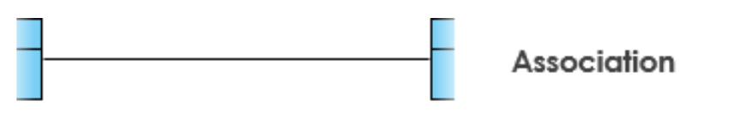

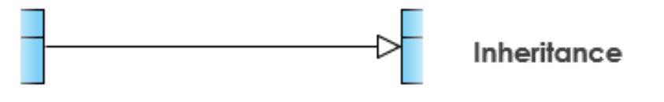
Class Relationships
Association
Two classes have some association
Indicated by a line
Composition/Aggregation
One class is a part of other class
Indicated by a line with diamond head
Inheritance/generalization
A class inherits from another class
Indicated by a line with arrow head

Slide 7
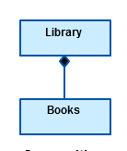
Composition
It is used to depict “has-a” relationship
If car and engine are two classes, then it will be a composition
Car
Engine

Slide 8
Inheritance / Generalization
It is used to depict “is-a” relationship
Good for code reusability

Slide 9
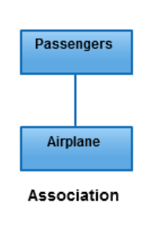
Association
Any other kind of relaionship can be termed as an association

Slide 10
Coding the Relationships
Composition
class Car { private: string brand; string model; int year;
Engine E; };
class Engine { private string name;
int cc; int cylinders; };
LIVE EXAMPLE

Slide 11
Coding the relationships
Inhertiance
class rectangle { private: int len;
int width; };
class box:public rectangle { private:
int height; };
LIVE EXAMPLE

Slide 12
Coding the relationships
Association
class flight { private: string flightname; string planemodel; string airline;
int seating; };
class Passenger { private: string name;
int id; string flightname; int seatNo; };
LIVE EXAMPLE

Slide 13
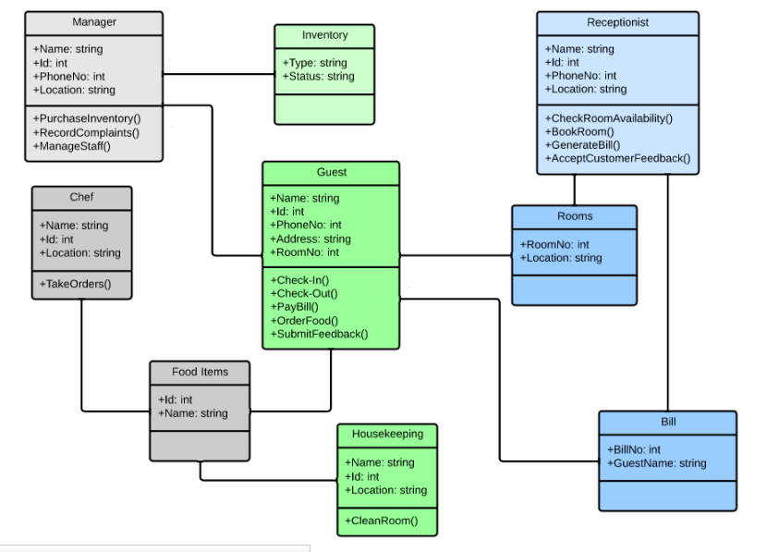
Hotel Management System

